Slide 1
SUMMARY DASHBOARD
HR ANALYTICS
Tran Anh Tuan

Slide 2


APPROACH
Overview Dim & Fact Using Mindmap in Xmind
Overview Tables Dim & Fact Tables ALL Dim & Fact
Design Relationship Relationship Dim With Fact

Slide 3
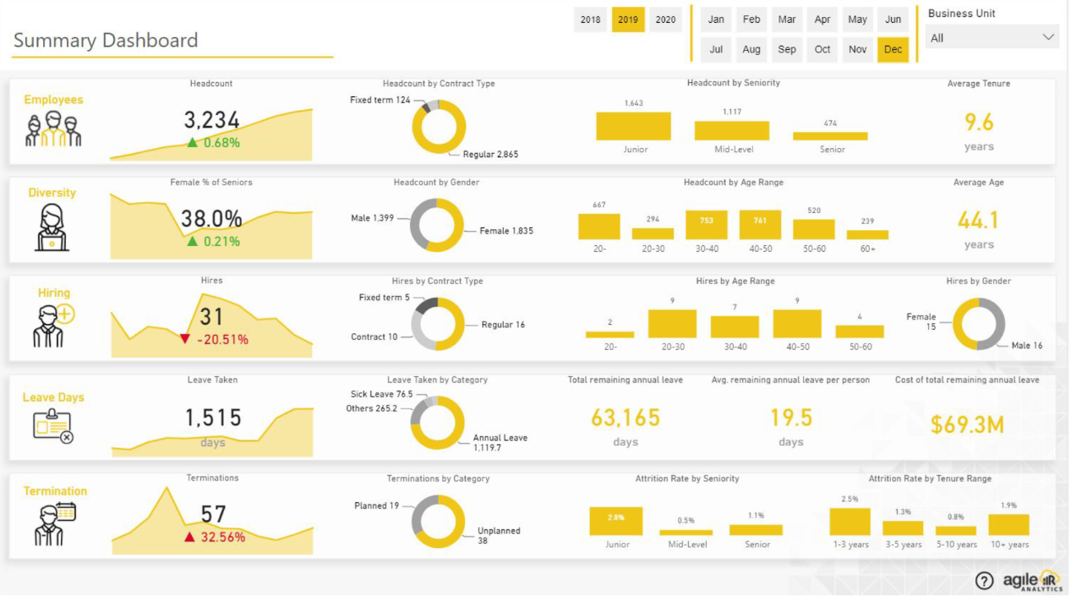
HR ANALYTICS - Summary Dashboard

Slide 4
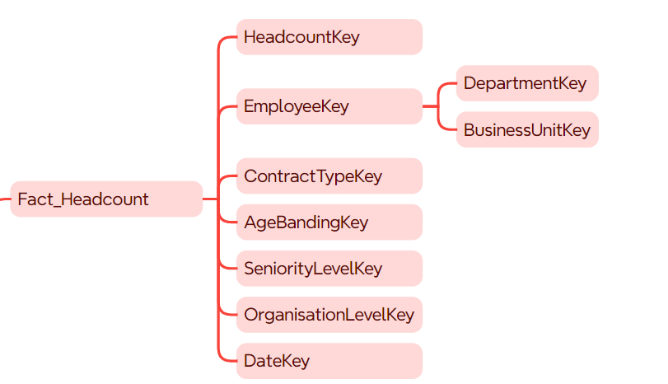
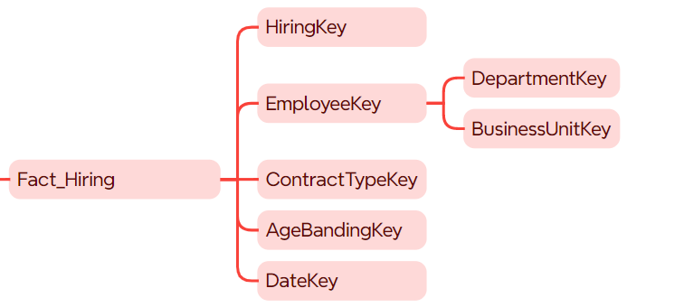
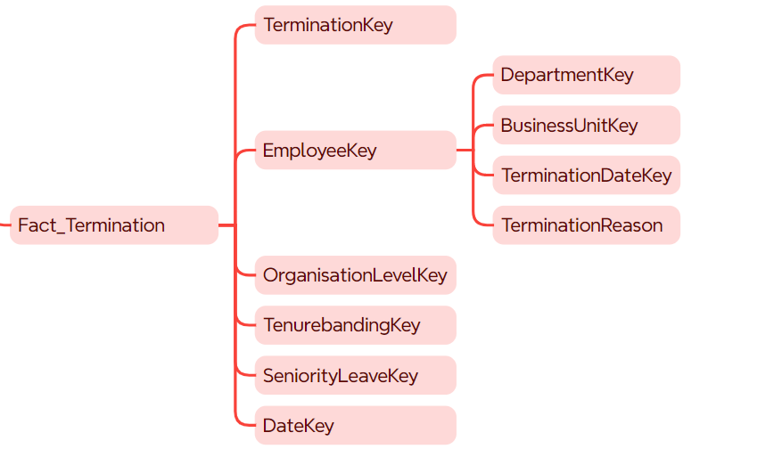
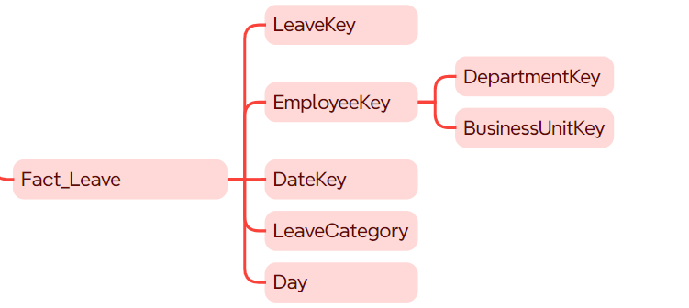
OVERVIEW - Xmind Fact Tables

Slide 5
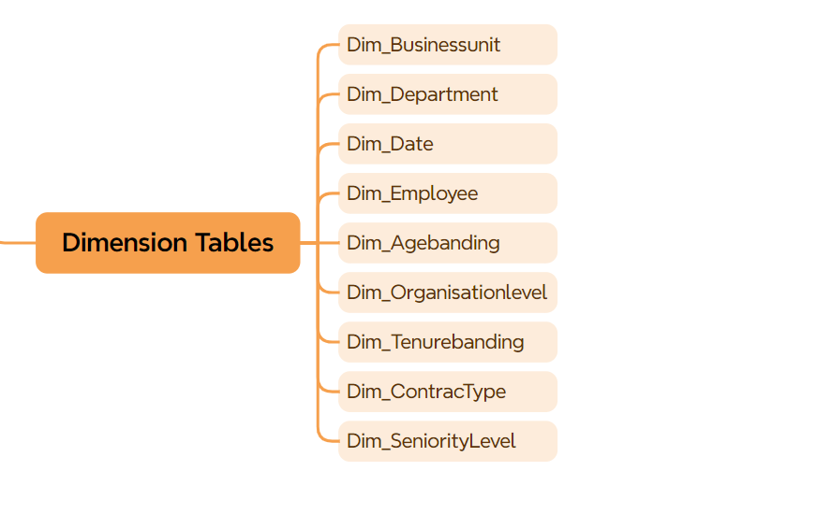
OVERVIEW - Xmind Dim Tables

Slide 6
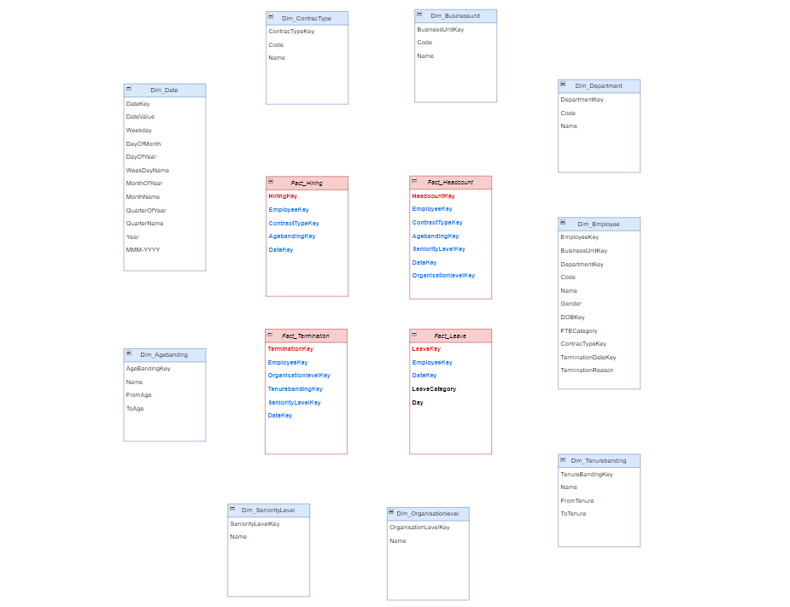
OVERVIEW TABLES DIM & FACT

Slide 7
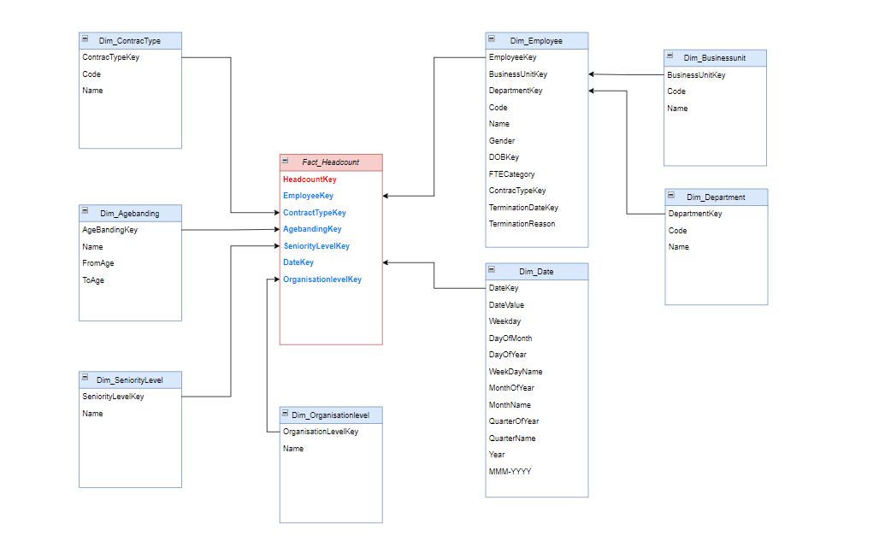
DESIGN RELATIONSHIP - Fact Headcount

Slide 8
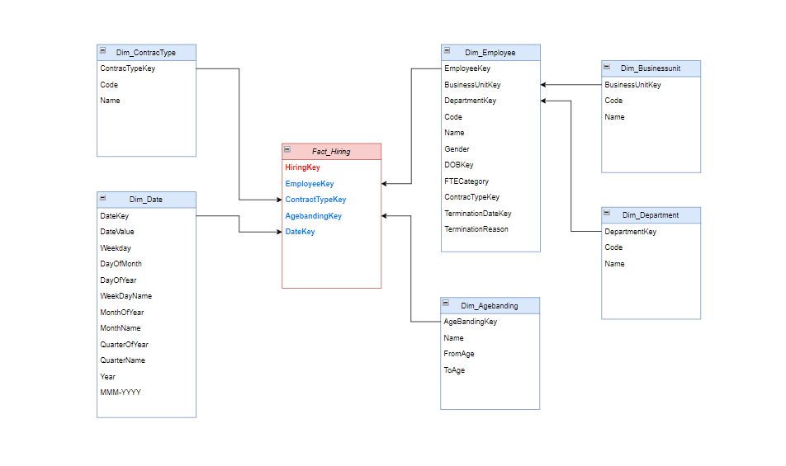
DESIGN RELATIONSHIP - Fact Hiring

Slide 9
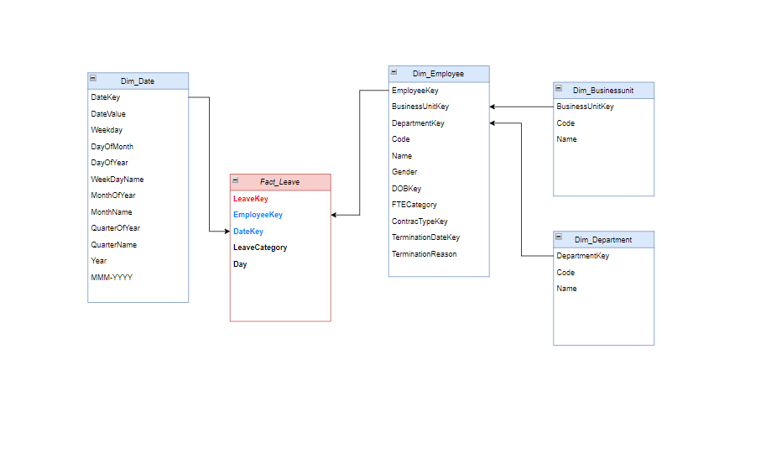
DESIGN RELATIONSHIP - Fact Leave

Slide 10
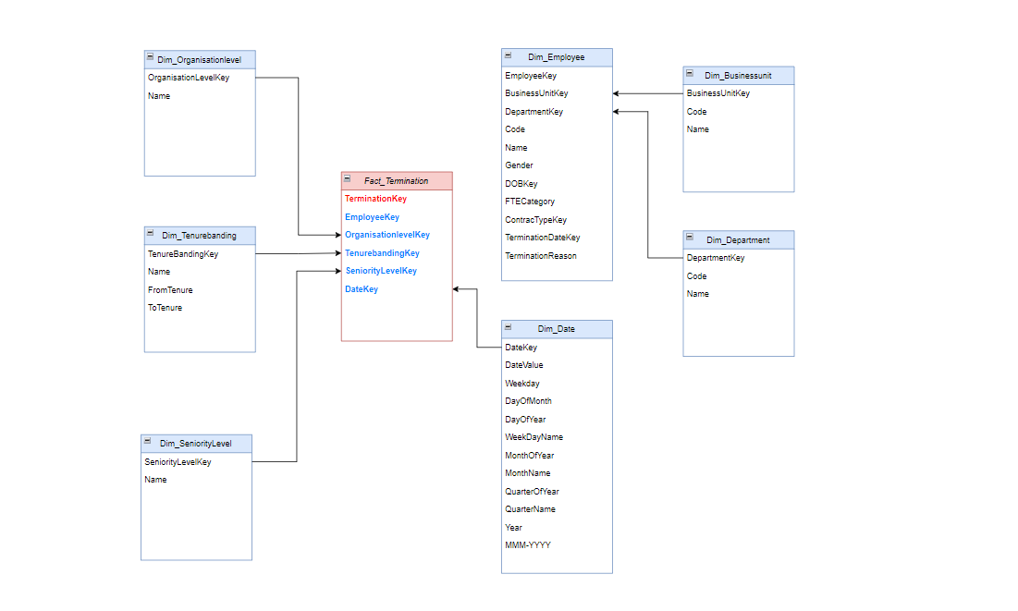
DESIGN RELATIONSHIP - Fact Termination

Slide 11


